Slide 1

ST Hackathon(Result) Geninus-SKKU
Heesoo Kim
Kyuran Lee
Doeon Gu
Yeonju Lee
2024.08.22

Slide 2
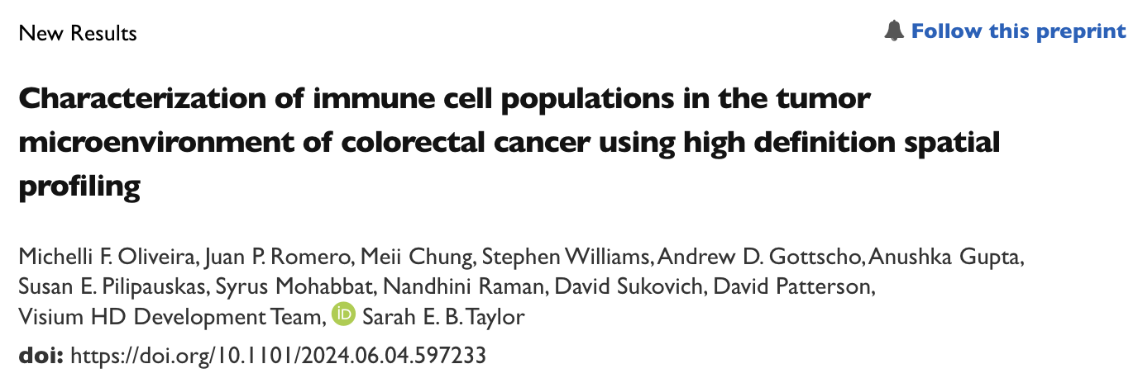
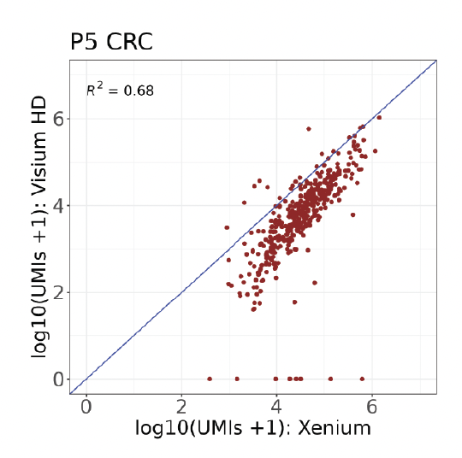
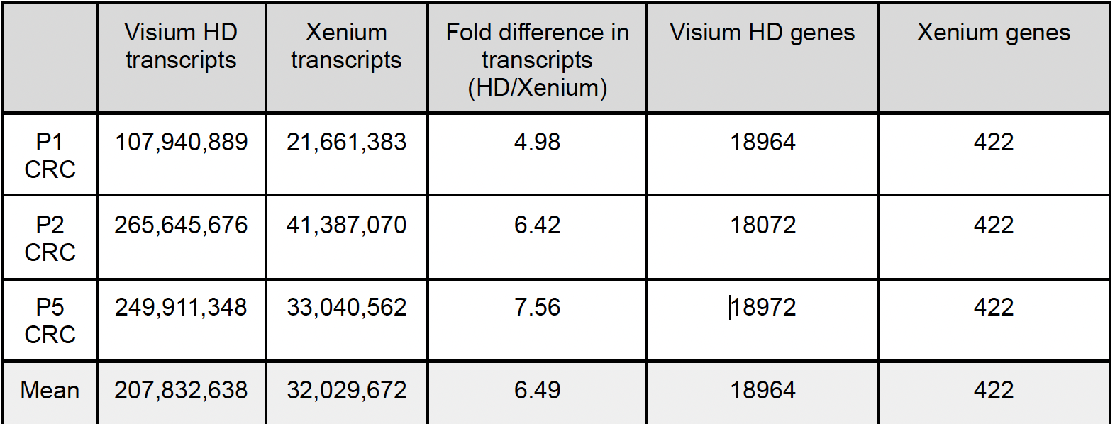
Background : Xenium + Visium HD
Whole transcript
Single cell
Visium HD
18,085gene
(whole transcriptome)
Bin
16, 8, 2 um binning
Xenium in situ
422 gene
Multimodal
segmentation
(Single cell resolution)
Integration Visium HD and Xenium
➔ Whole transcriptome & single cell resolution
at spatial level

Slide 3
Workflow
8μ vs 16μ vs nuclei vs boundary
Deconvolution Visium HD
(by xenium)
Image alignment
Xenium coord
transformation
integration
Xenium → Visium HD deconvolution
Result of integration
Evaluation
Downstream analysis
Visium HD
segmentation
By affine matrix
Xenium annotation
(by canonical marker)
Gene correlation
Cell-cell interaction
Xenium DAPI
+
Visium HD H&E
Nuclei / boundary
Min distance approach
Xenium DAPI Image + Visium HD H&E image → Affine matrix → transformation of xenium coordinate
Segmentation of Visium HD (nuclei, boundary)
Xenium annotation w/morphology
Xenium → Visium HD deconvolution(8, 16, nuclei, boundary)
Integration of Visium HD and xenium
Evaluation of integration V and X
Downstream analysis → cell-cell interaction, GSEA

Slide 4
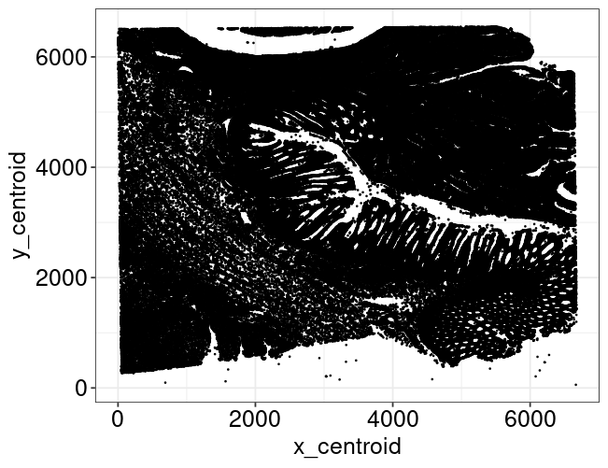
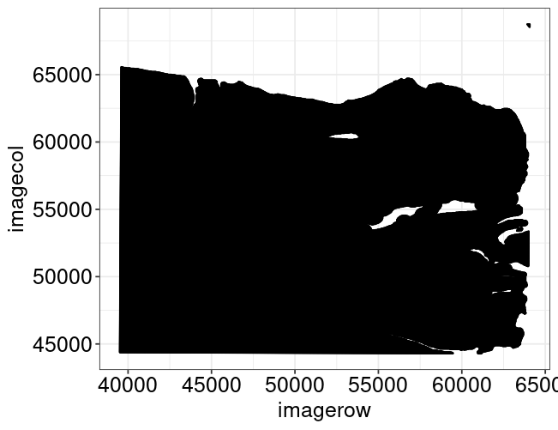
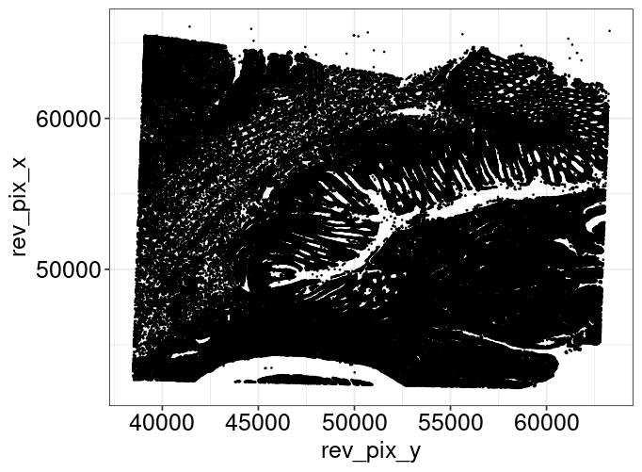
1. Image alignment of Xenium DAPI + Visium HD H&E
Manually image alignment of Xenium DAPI and Visium HD H&E in xenium explorer.
Transformation of Xenium um to Visium HD pixel coordinate using Affine matrix.
Visium to Xenium
Xenium to Visium
-0.02483 | 1.28649 | -48408.9
-1.28649 | -0.02483 | 86488.58
0 | 0 | 1
-0.015 | -0.77702 | 66477.27
0.777019 | -0.015 | 38911.85
0 | 0 | 1
Inverse Matrices
Xenium um coordinate
Visium HD pixel coordinate
Transformed xenium coordinate
Successful transformation between two different image using the affine matrix.

Slide 5
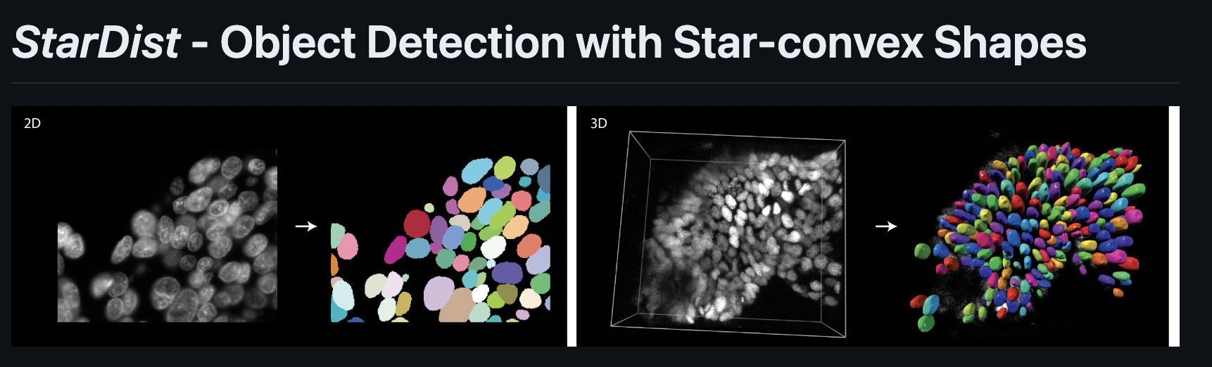
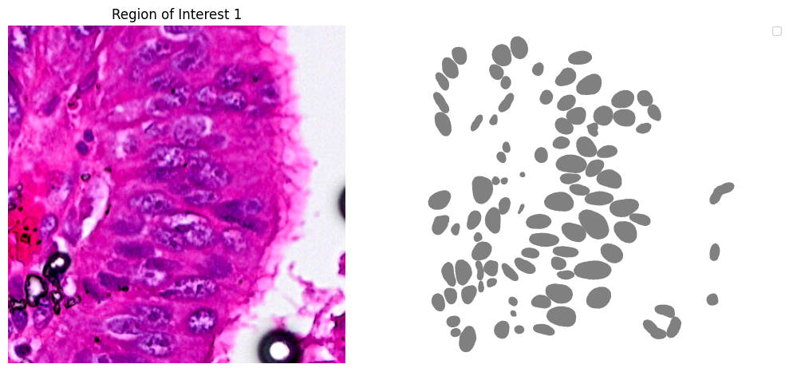
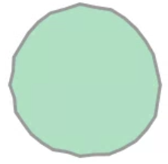
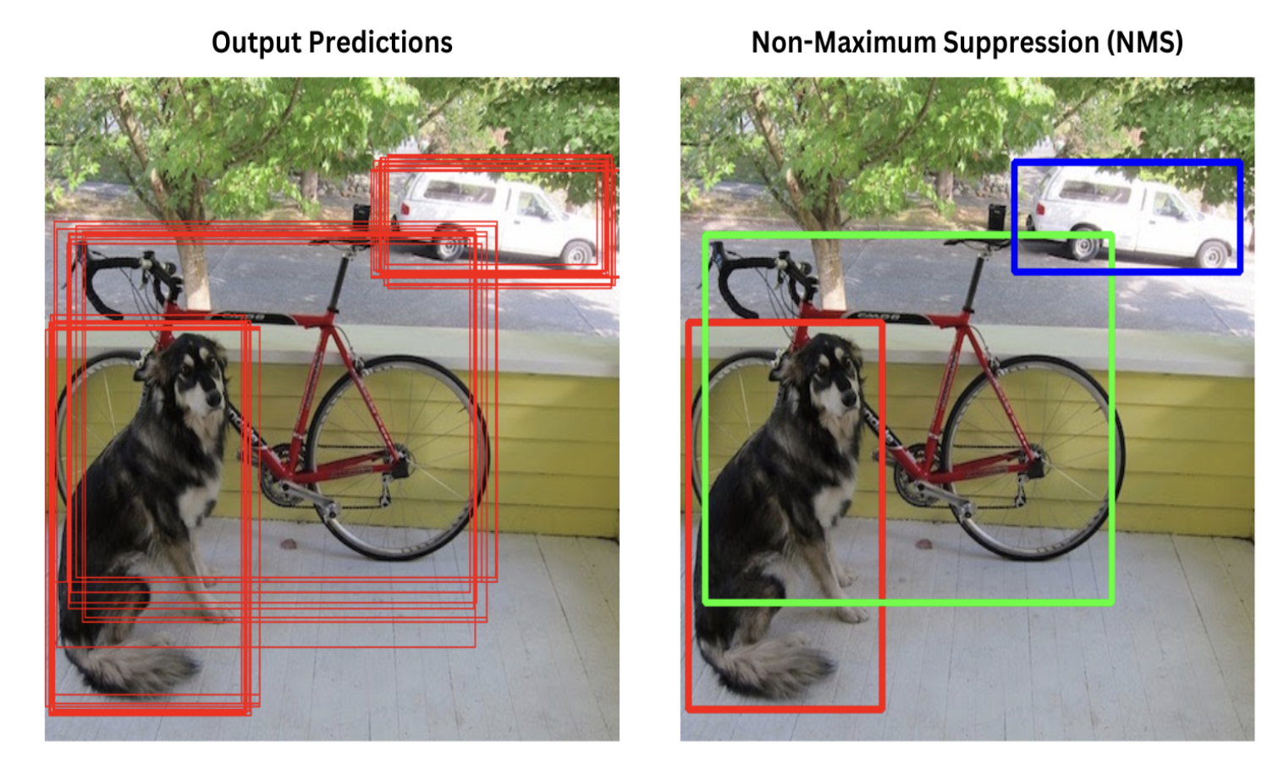
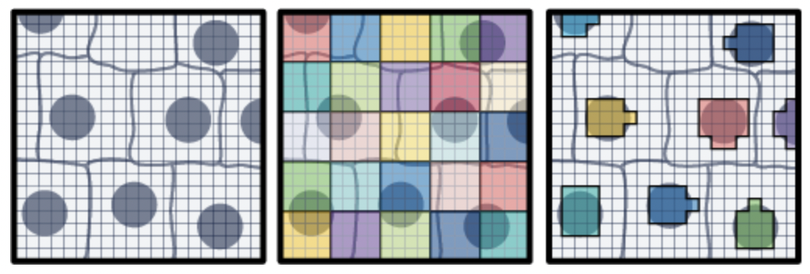
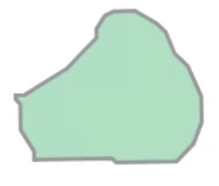
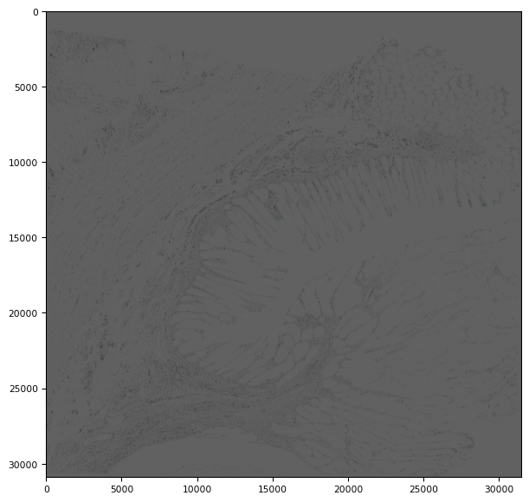
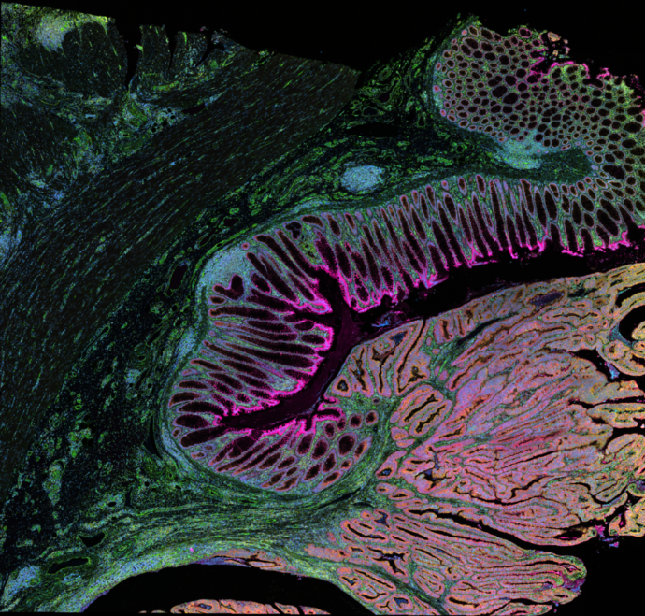

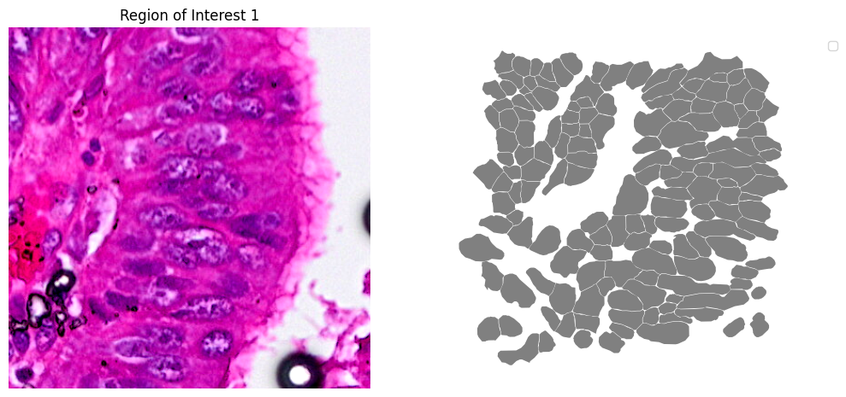
2. Segmentation of Visium HD (nuclei, boundary)
Nuclei segmentation
*Detection of nuclei using StarDist
Non max supression
270,978 nuclei
Mean 6 bins
Custom binning
*Remove doublet
Nuclei
Boundary segmentation
246,933 cells
Mean 14 bins
Xenium multimodal segmentation result
Boundary
Applying boundary segmentation results in a 2.33-fold increase in bin count(2 um).

Slide 6
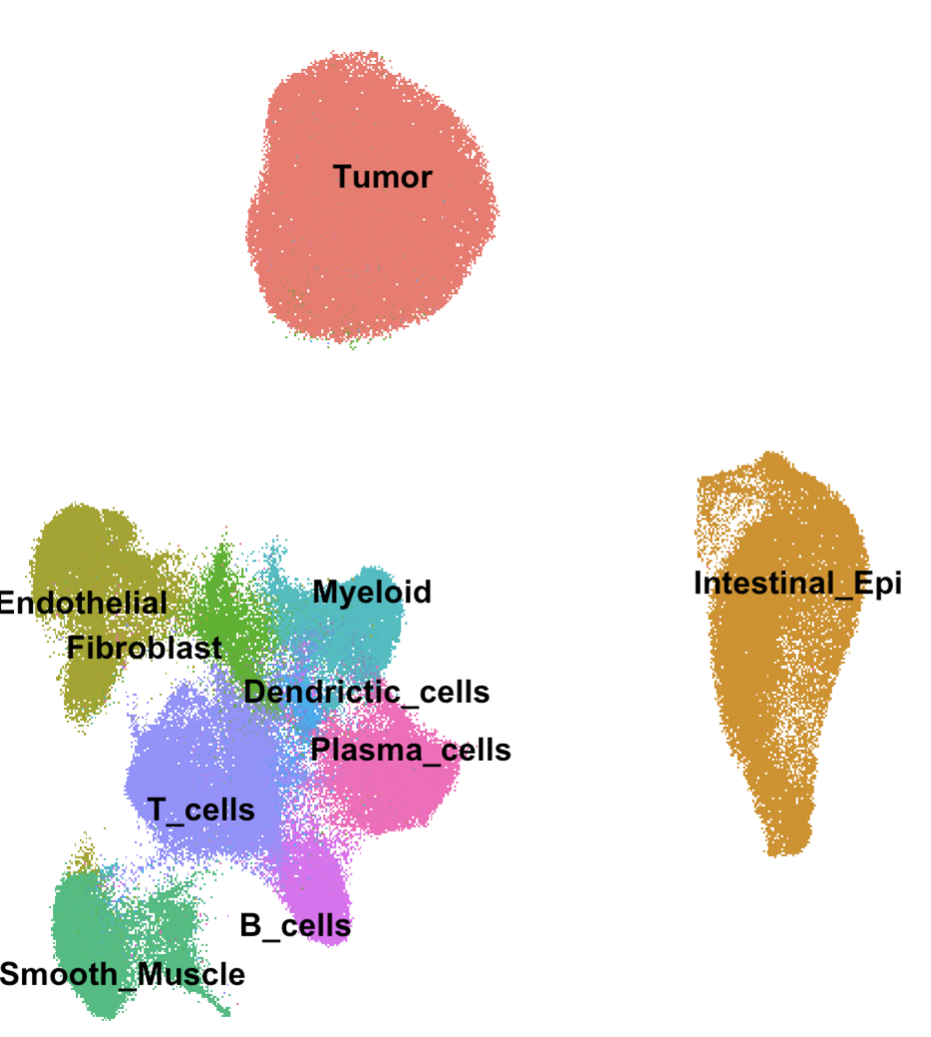
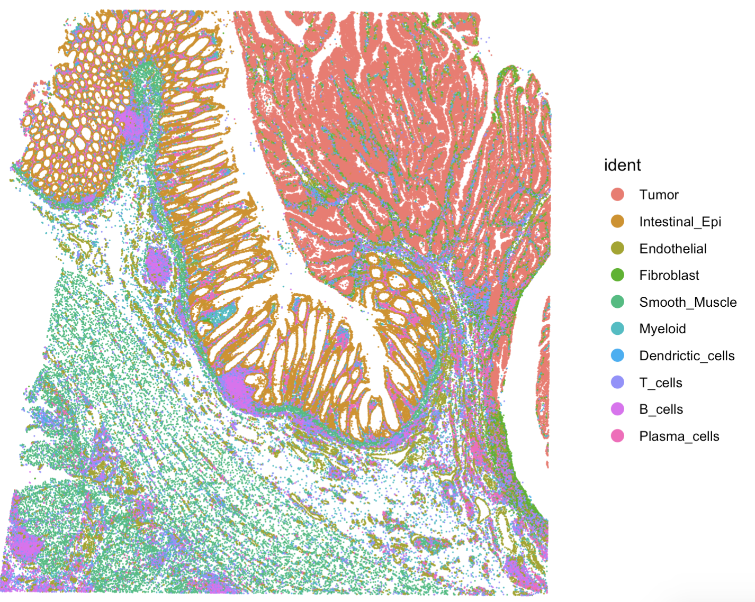
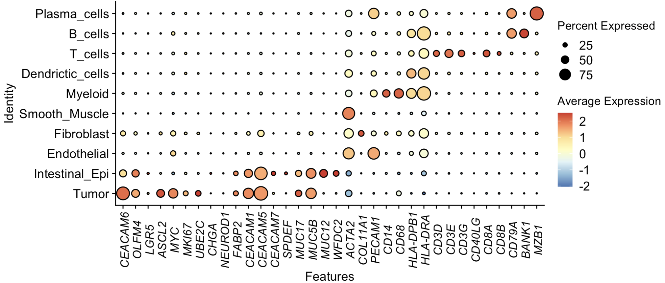
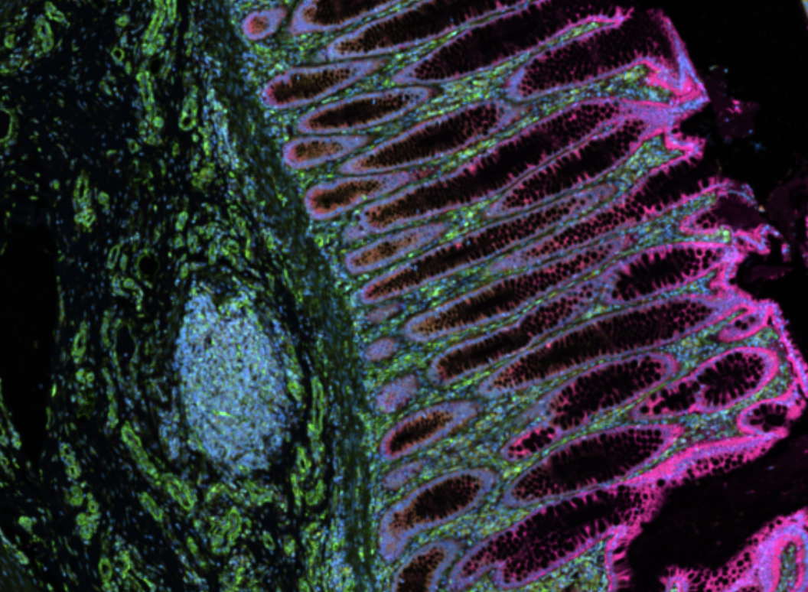
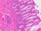
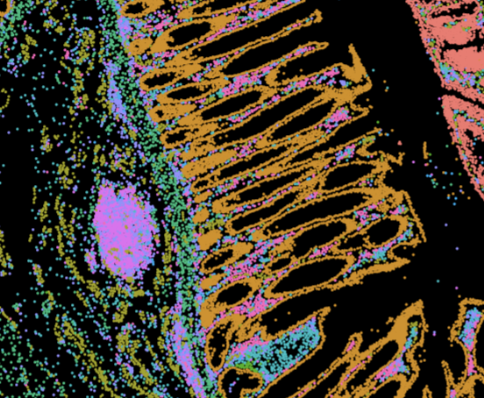
3. Xenium annotation
Xenium In Situ, Sample P5 CRC
422 features * 234,944 cells
UMAP2
UMAP1
Canonical marker-based annotation reflects morphology well in spatial mapping results in xenium data.

Slide 7
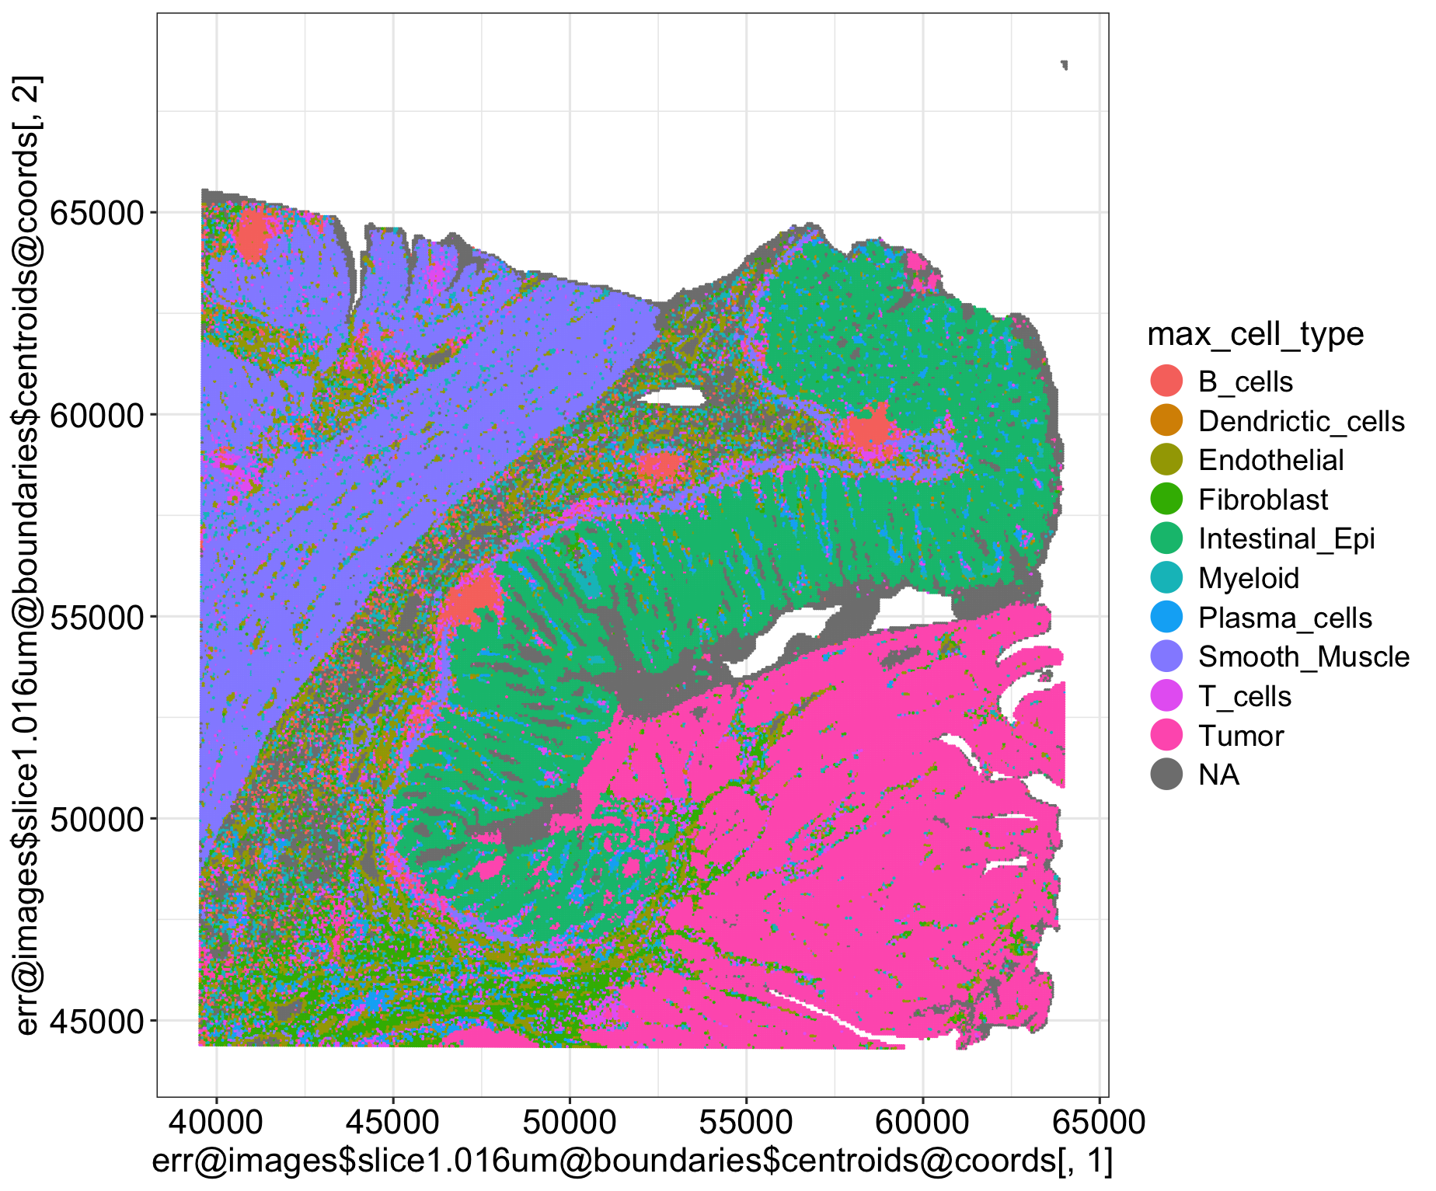
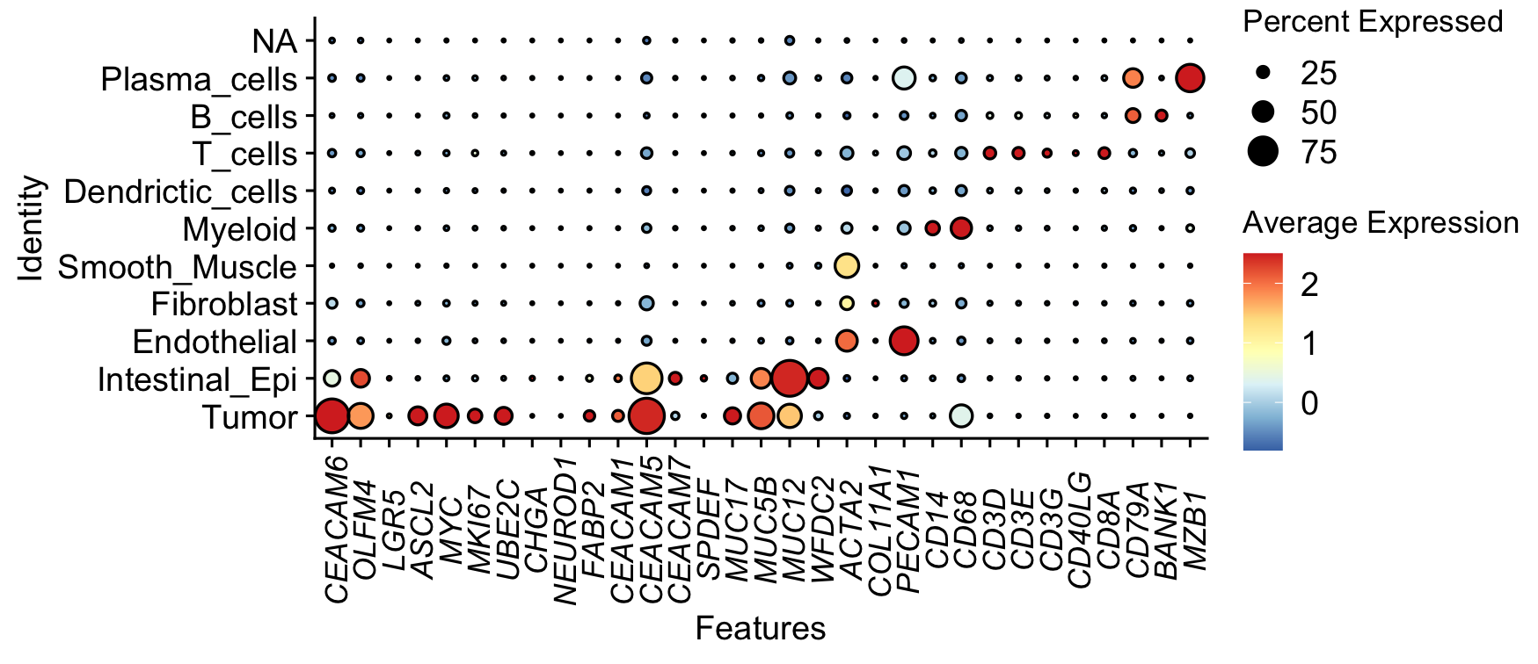
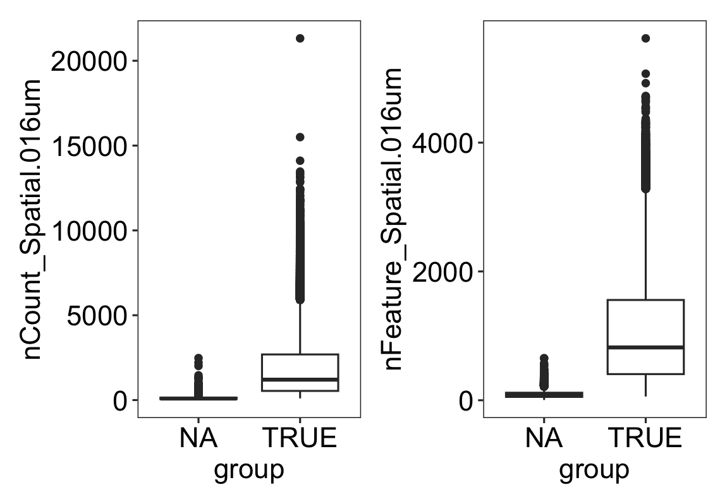
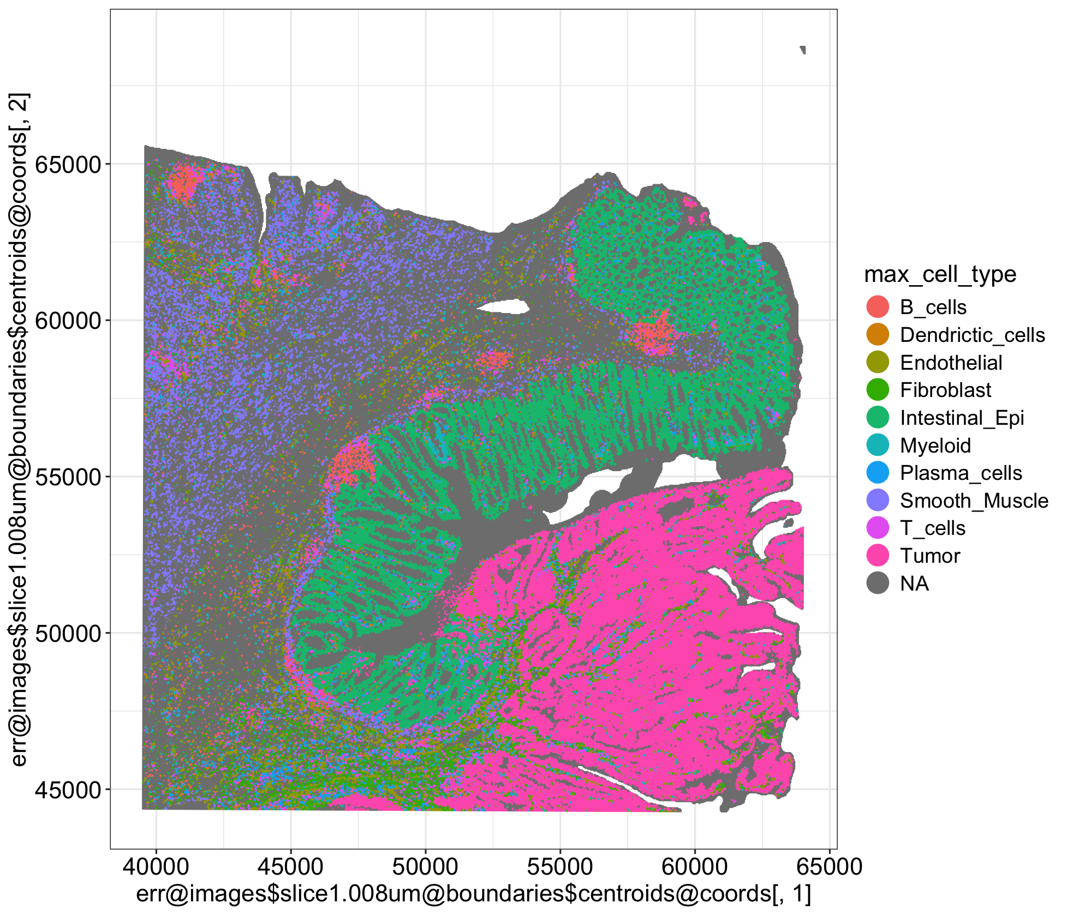
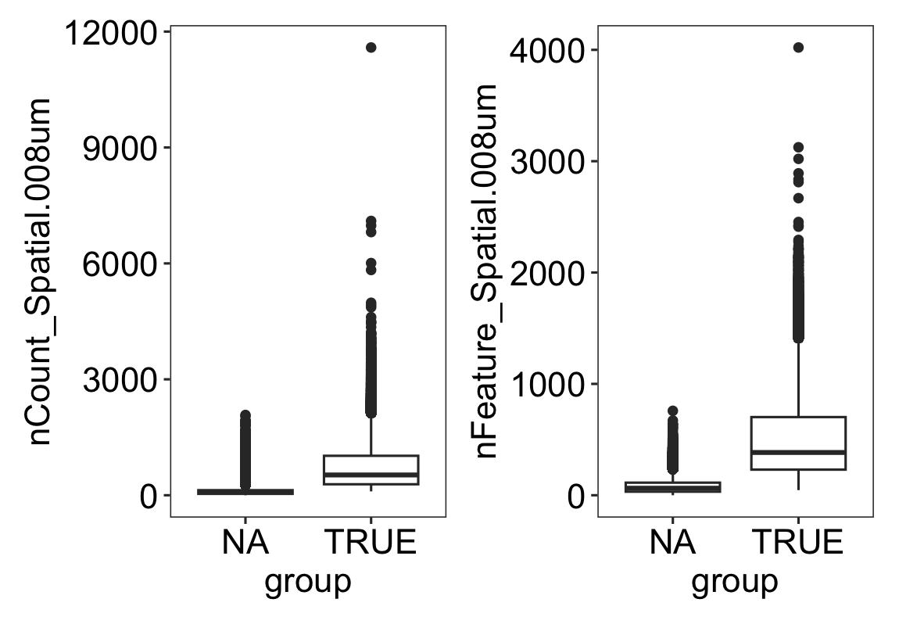
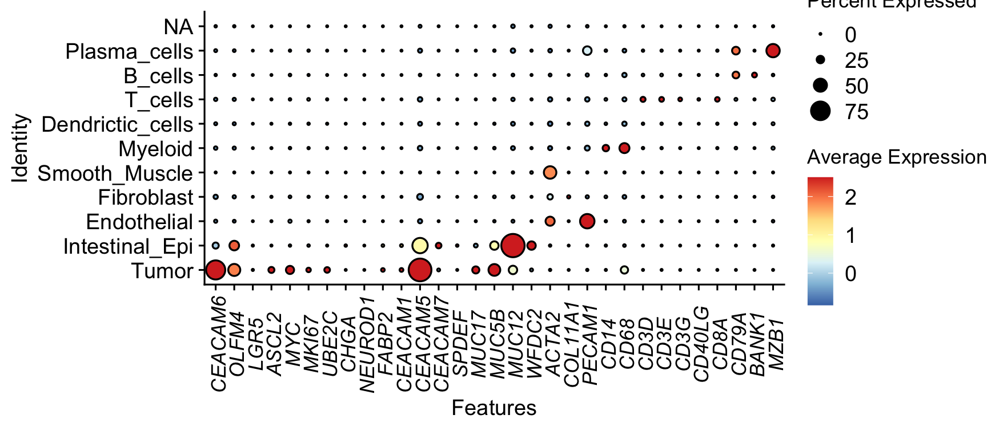
4. Xenium → Visium HD deconvolution(bin level)
Deconvolution
Visium HD (16um)
NA Singlet
15,035 121,000
11%
Visium HD (8um)
NA Singlet
238,084 303,884
44%

Slide 8
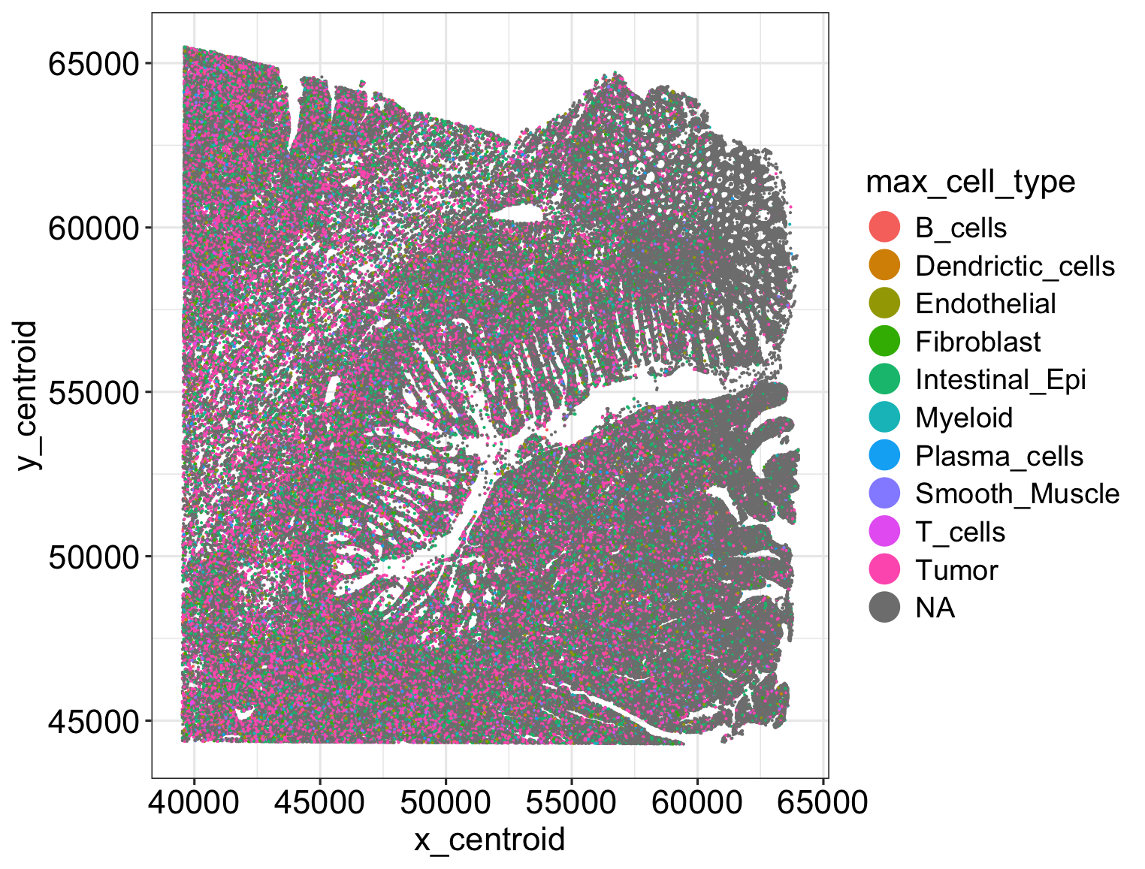
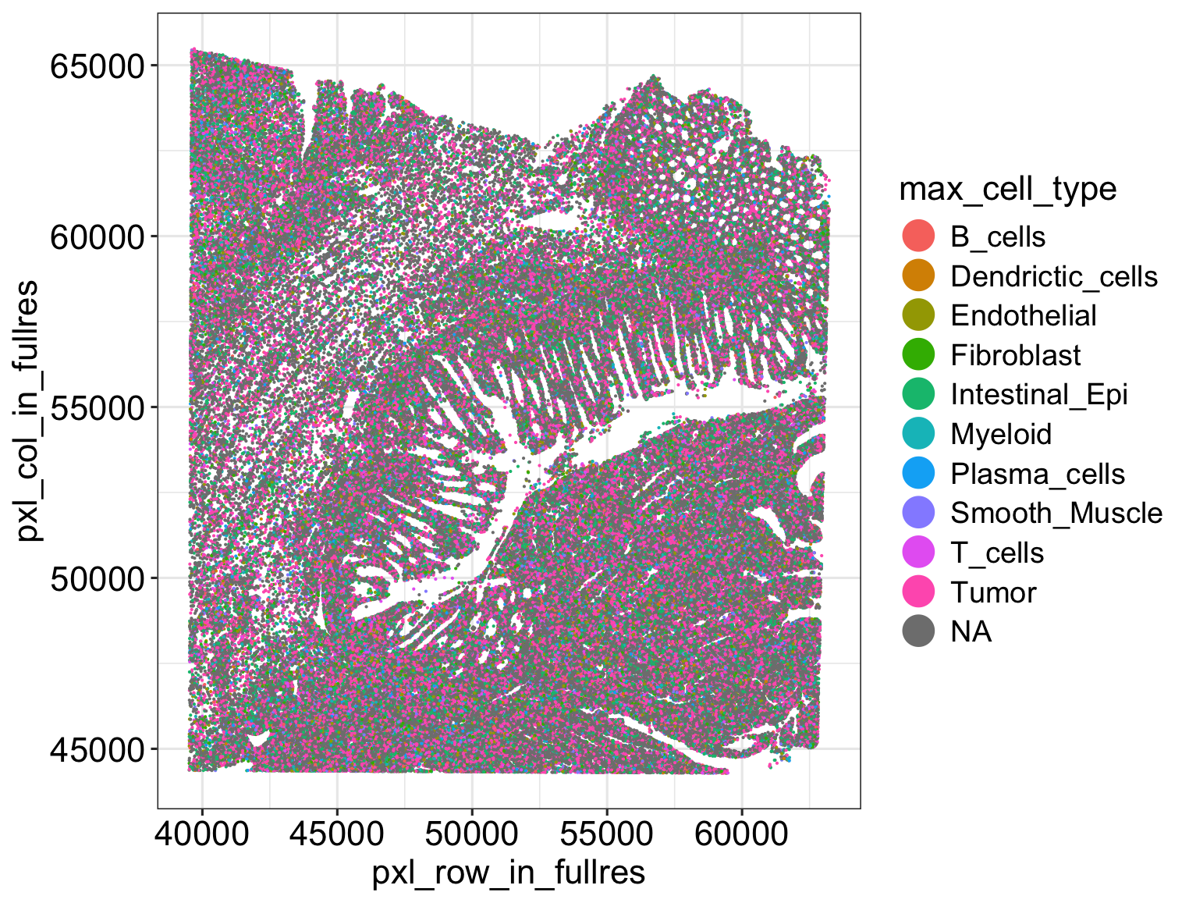
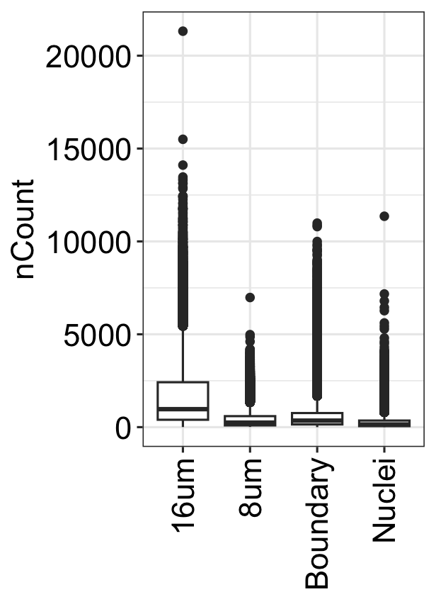
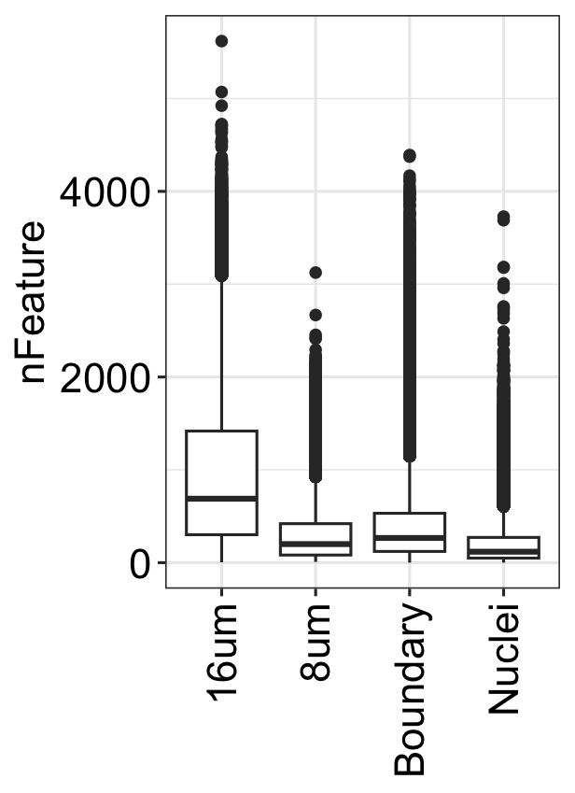
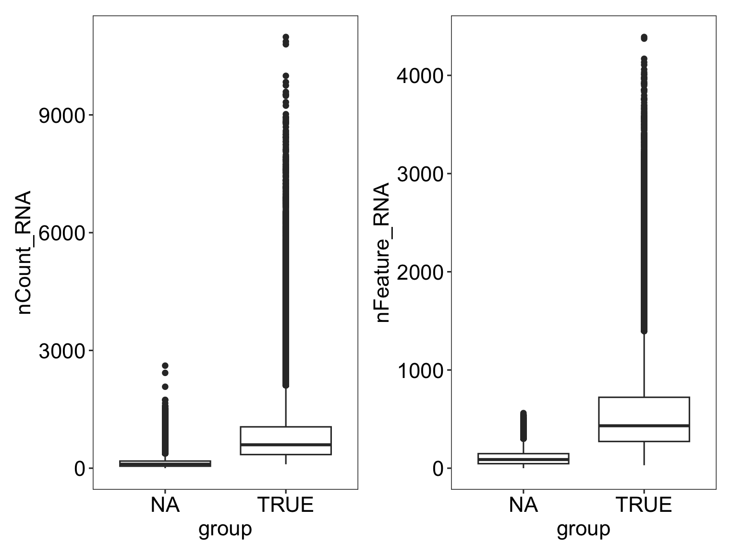
4. Xenium → Visium HD deconvolution(segment level)
Deconvolution
Visium HD
Left :(Nuclei Segmentation ; Visium HD H&E image)
Right : (Boundary Segmentation ; Xenium multi modal)
 | 16 um | 8 um | Boundary | Nuclei
deconvolution % | 89% | 56% | 64% | 37%
bin count | 64 | 16 | 14 | 6
mean feature | 1010 | 311 | 402 | 208
mean count | 1759 | 432 | 591 | 273
NA TRUE
170,306 100,672
63%
NA TRUE
88,842 158,091
36%
Low count and low features cause deconvolution failure.
Boundary segment captures more transcripts and genes than 8 µm, showing its high sensitivity.

Slide 9
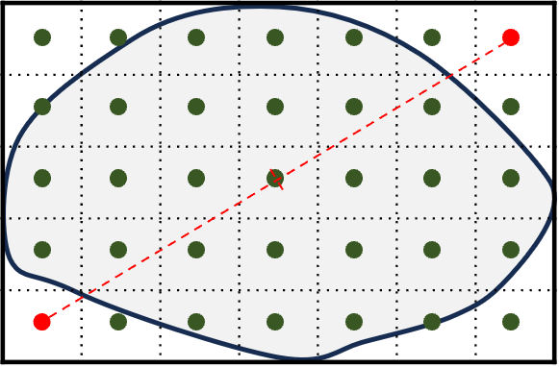
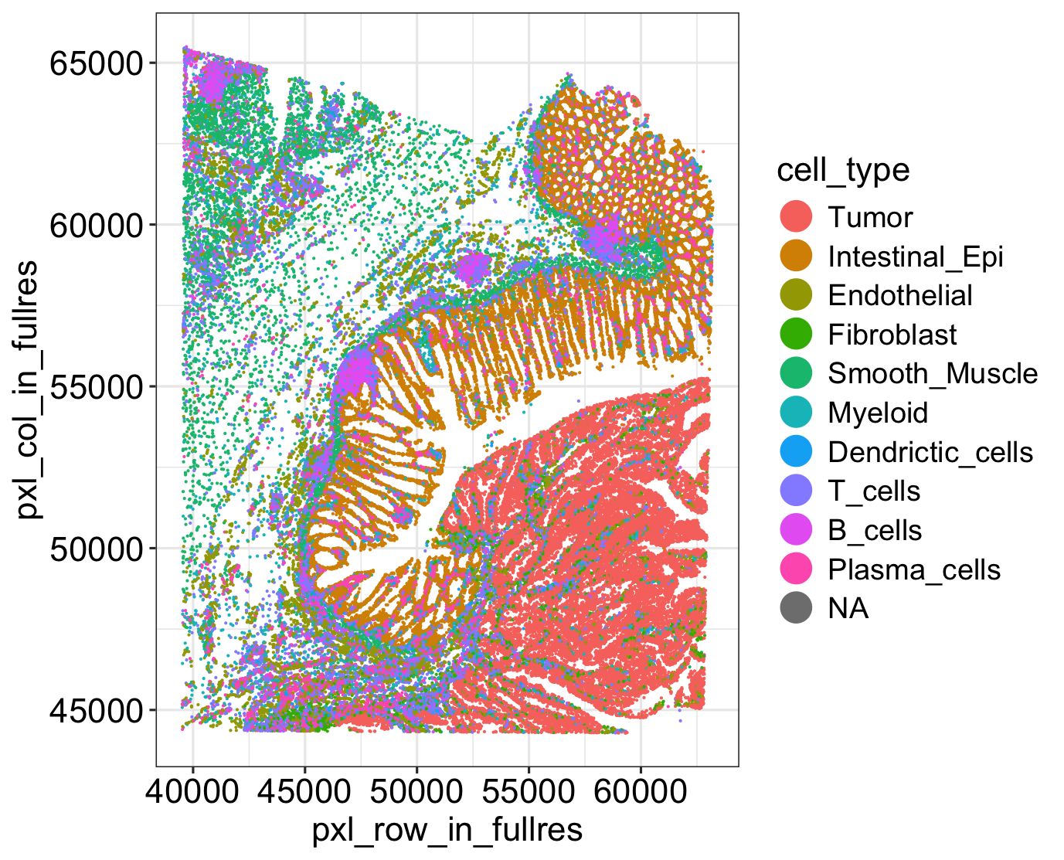
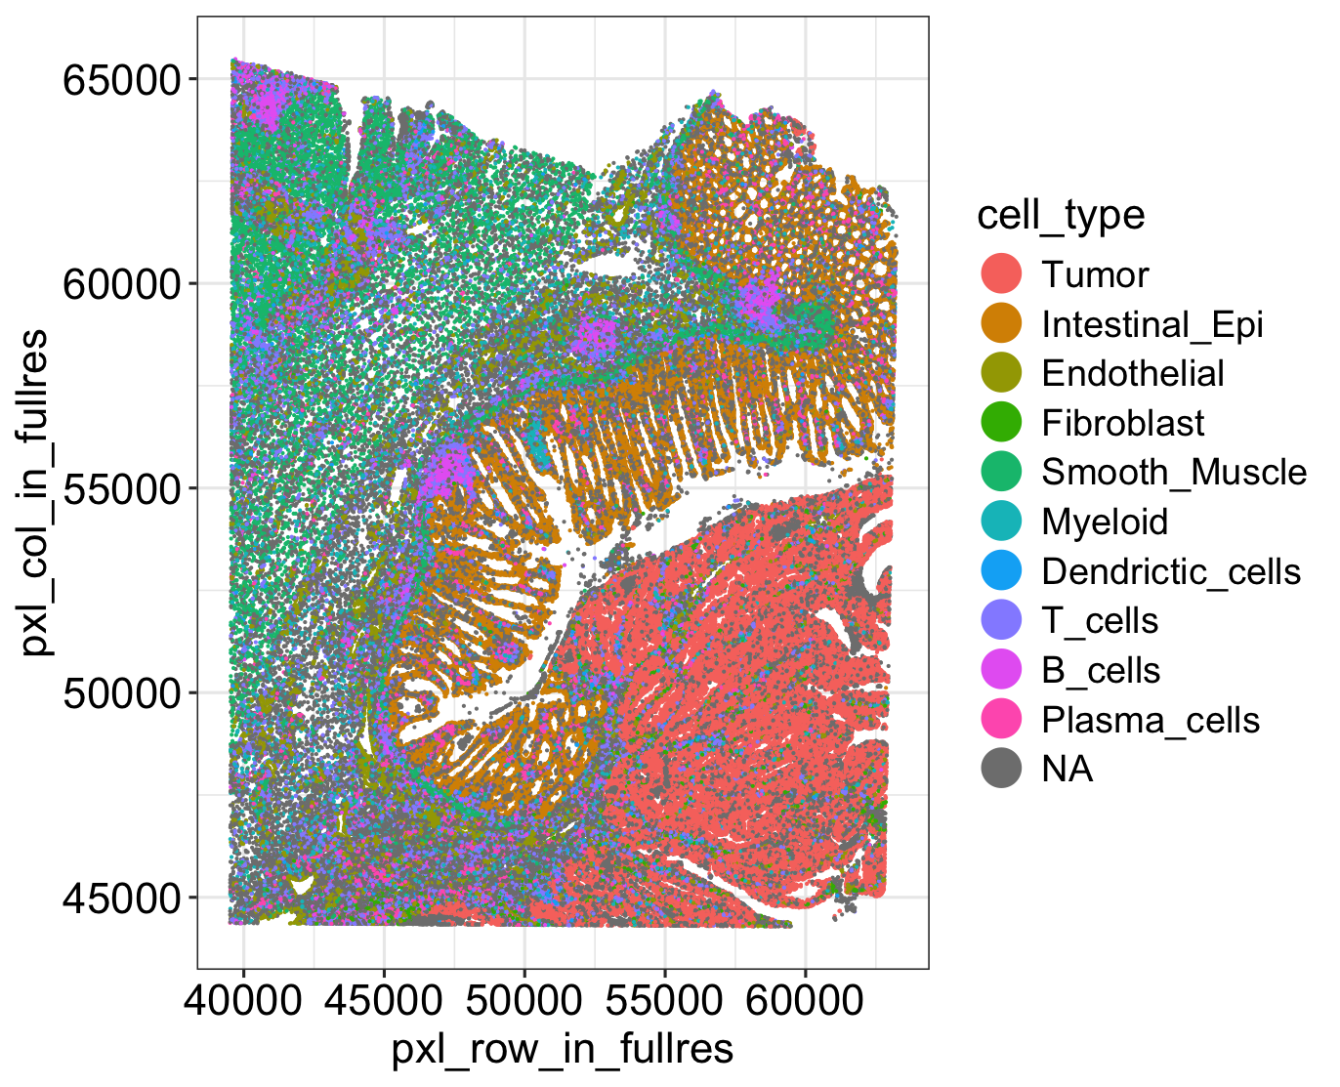
5. Location-based integration of Visium HD and Xenium
Max point
C_{max} distance
min(C_{min} + C_{max} distance) & C_{min} distance ≒ C_{max} distance → Centroid bin
min(bin-xenium nucleus distance) < 2 um(boundary, 8) or 4 um(nuclei)
C_{min} distance
2um
4um
Nuclei
Boundary
87,064 nuclei
183,011 cells
Min point
 | 0 | 1 | 2 | 3 | 4 | 5 | 6
8 um | 62.46 | 30.18 | 6.73 | 0.59 | 0.03 | 0.001 | 0.000185
Nuclei | 54.88 | 37.67 | 6.89 | 0.49 | 0.06 | 0.002 | 0.004797
Boundary | 6.57 | 87.61 | 5.58 | 0.23 | 0.01 | 0 | 0
*Cell %
Boundary segments exhibit the highest rate of matching with single cells, being the closest to single-cell resolution.

Slide 10
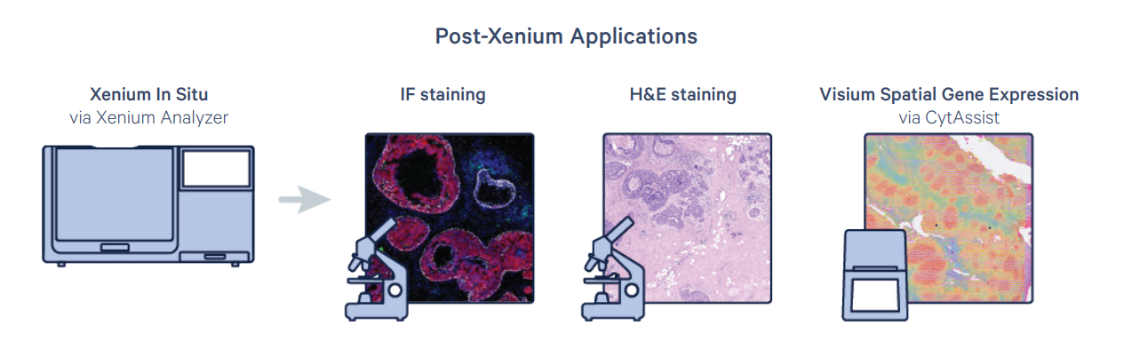
Discussion
Insight
Visium HD : 8 µm, Nuclei Segment: Low sensitivity and bin counts; does not reveal single cells. Nuclei Segment: Data loss. (90%) Xenium-Boundary Segment: Provides the highest single-cell resolution and sensitivity.
➔ Propose the Location-based Integration
Limitation
Xenium DAPI image and Visium HD H&E image that do not perfectly align. (different sections)

